Slide 1
Deep Visual-Semantic Alignments for Generating Image Descriptions
OLAYINKA SOYINKA
KEERTHI REDDY GANGIDI

Slide 2
CONTENTS
Introduction
Methodology
Implementation
Experiments
Conclusion

Slide 3
Introduction
As the title suggests this paper explained the implementation of a network capable of generating descriptions when supplied with an image.
Most of the papers in the class already deal with just binary classification (either it is something or not) or just identification of an area of interest in an image.

Slide 4
This paper takes a step further by adding an element of describing objects in the image rather than just classification or identification.
As we’ve established in this class all the modelling done is to try to simulate the way we humans do things and this isn’t any different and as always it is easy for us humans to do and elusive for out computer counterparts.

Slide 5
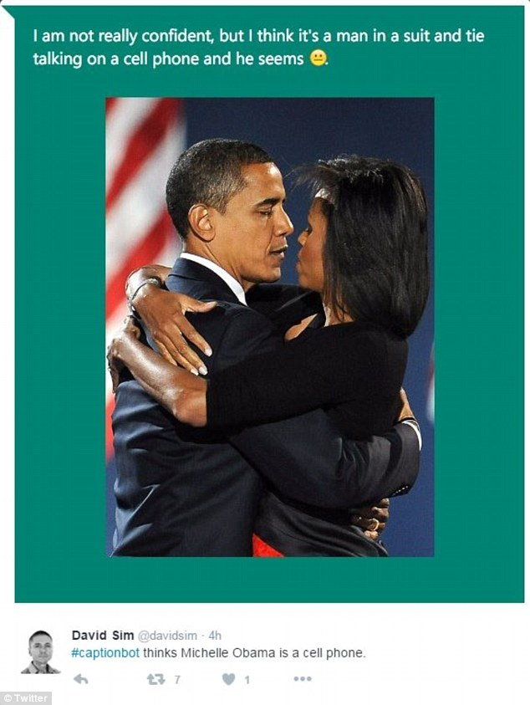
Figure 1. The description Microsoft’s caption bot gives the image.

Slide 6
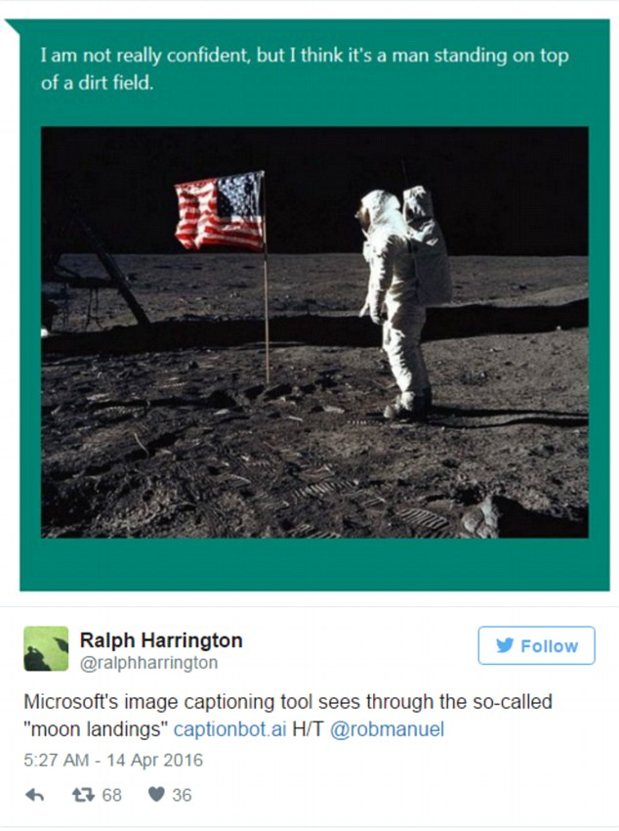
Figure 2. Pretty close description..

Slide 7
As the images have shown, description by computers can be very limited and restrictive and the authors of the paper tried to implement a system that does away with these restrictions and be able to generate dense descriptions of images.
Their aim is in the design of a model that is rich enough to simultaneously reason about contents of images and their representation in the domain of natural language. Additionally, the model should be free of assumptions about specific hard-coded templates, rules or categories and instead rely on learning from the training data.

Slide 8
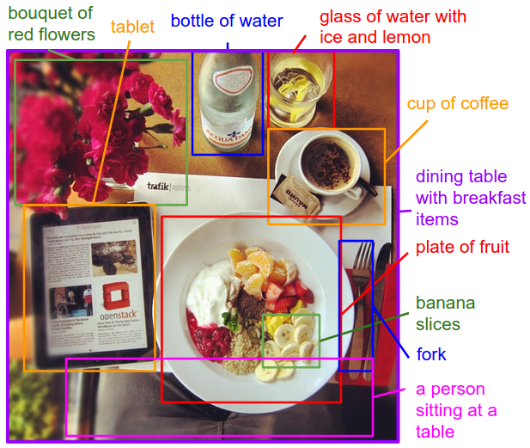
Figure 3. Image showing the goal.

Slide 9
METHODOLOGY
Some pioneering approaches that address the challenge of image descriptions have been developed However, these models often rely on hard-coded visual concepts and sentence templates, which imposes limits on their variety.
Moreover, the focus of these works has been on reducing complex visual scenes into a single sentence, which we consider to be an unnecessary restriction.

Slide 10
Their method involved leveraging large image sentence datasets by treating the sentences as weak labels, in which contiguous segments of words correspond to some particular, but unknown location in the image. This is possible through datasets of image captions which are available in large quantities on the internet but these descriptions multiplex mentions of several entities whose locations in the images are unknown

Slide 11
They divided their work into two parts
Develop a deep neural network model that infers the latent alignment between segments of sentences and the region of the image that they describe.
Introduce a multimodal Recurrent Neural Network architecture that takes an input image and generates its description in text.

Slide 12
MODEL
The ultimate goal of the model is to generate descriptions of image regions. During training, the input to our model is a set of images and their corresponding sentence descriptions . We first present a model that aligns sentence snippets to the visual regions that they describe through a multimodal embedding. We then treat these correspondences as training data for a second, multimodal Recurrent Neural Network model that learns to generate the snippets.

Slide 13
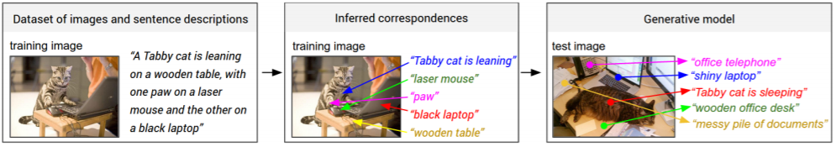

Slide 14
Multimodal Recurrent Neural Network for generating descriptions
The general idea behind this model is to predict a variable-sized sequence of outputs given an image. This is achieved by defining a probability distribution of the next word in a sequence given the current word and context from previous time steps

Slide 15
Training.
The RNN is trained to combine a word, the previous context to predict the next word . We condition the RNN’s predictions on the image information via bias interactions on the first step. The training proceeds as follows : We initialize with a special START vector, and the desired label as the first word in the sequence. Analogously, we feed to the network the word vector of the first word and expect the network to predict the second word, etc. Finally, on the last step when we get the last word, the target label is set to a special END token. The cost function is to maximize the log probability assigned to the target labels

Slide 16
Testing
To predict a sentence, we compute the image representation , set the START vector and compute the distribution over the first word. We sample a word from the distribution (or pick the argmax), set its embedding vector and repeat this process until the END token is generated.

Slide 17
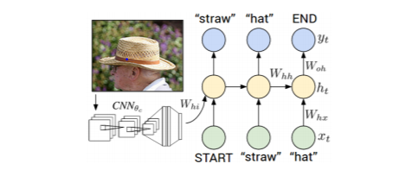

Slide 18
Experiments
Datasets:
They used the Flickr8K, Flickr30K and MSCOCO datasets in experiments. These datasets contain 8,000, 31,000 and 123,000 images respectively.
Each is annotated with 5 sentences using Amazon Mechanical Turk.
For Flickr8K and Flickr30K, they used 1,000 images for validation, 1,000 for testing and the rest for training and for MSCOCO they used 5,000 images for both validation and testing.
Data Preprocessing:
converts all sentences to lowercase, discard non-alphanumeric characters.
Filter words to those that occur at least 5 times in the training set, which results in 2538, 7414, and 8791 words for Flickr8k, Flickr30K, and MSCOCO datasets respectively.

Slide 19
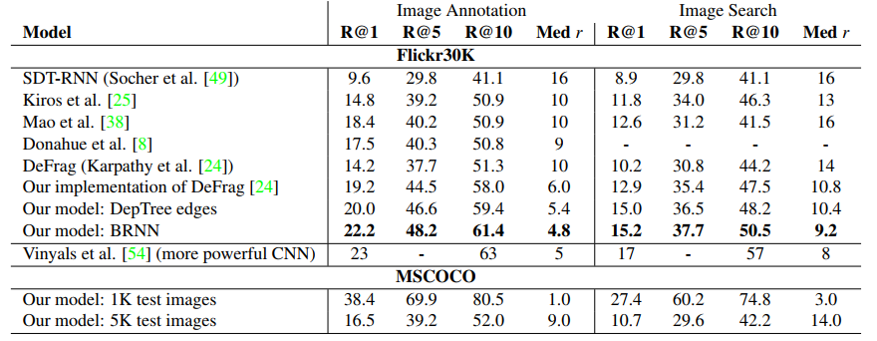
Generated Descriptions: Retrieval evaluation
First the quality of the inferred text and image alignments with ranking experiments are investigated.
Recall@K, which measures the fraction of times a correct item was found among the top K results.
This is based on S_{kl} ; k-image l-sentence.
Table 1. Image-Sentence ranking experiment results.

Slide 20
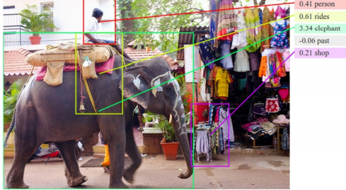
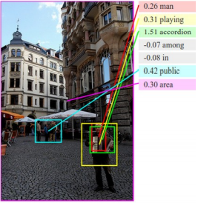
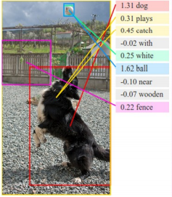
Fig: Example alignments.

Slide 21
simpler cost function improves performance.
Source of performance is well understood and BRNN is replaced with dependency tree relations resulting in low cost and consistent improvements.
BRNN outperforms dependency tree relations.
Dependency relations works better for single or bigrams.
But, BRNN can work successfully with longer than two words.
Qualitative.
This model discovers interpretable visual-semantic correspondences, even for small or relatively rare objects such as an “accordion”. These would be likely missed by models that only reason about full images.

Slide 22
Generated Descriptions: Full frame evaluation
Multimodal RNN to generate sentences on full images with the goal of verifying that the model is rich enough to support the mapping from image data to sequences of words.
For these full image experiments they used the more powerful VGGNet image features.
Reported the BLEU , METEOR and CIDEr scores computed with the coco-caption code.
Each method evaluates a candidate sentence by measuring how well it matches a set of five reference sentences written by humans.

Slide 23
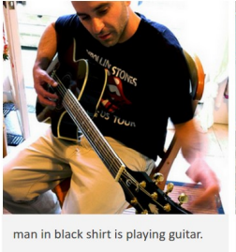
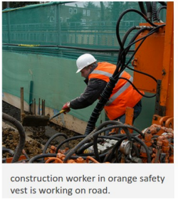
Qualitative
This model generates sensible descriptions of images.
“man in black shirt is playing a guitar” does not appear in the training set.
“man in black shirt”-20 times, “is paying guitar”-60 times.
Finally, description.

Slide 24
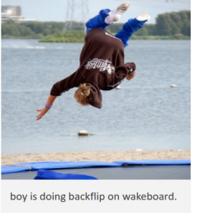
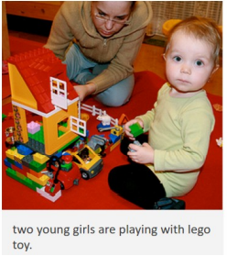
Failure cases
This model is not successful for all images

Slide 25
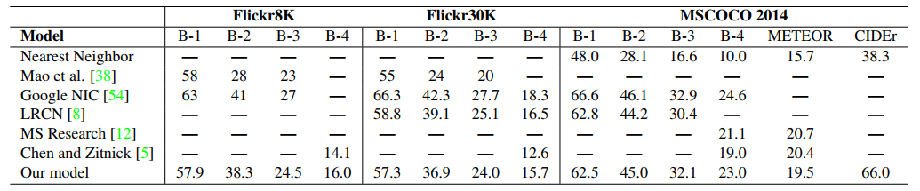
Multimodal RNN outperforms retrieval baseline
This model annotate each test image with a sentence of the most similar training set image as determined by L2 norm over VGGNet features.
This MRNN takes only a fraction of a second to evaluate per image.
Table 2. Evaluation of full image predictions on 1,000 test images.

Slide 26
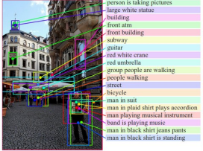
Generated Descriptions: Region evaluation
Trains the model between image regions and text snippets. To support this evaluation they used AMT(Amazon Mechanical Turk) and collected a new data set which is to be used at test time.
The Labeling interface displays a image and annotators are supposed to draw five bounding boxes and annotate with text.

Slide 27
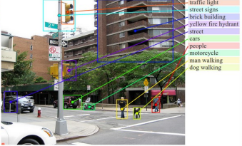
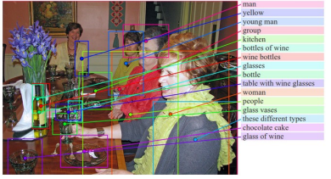
Fig: Examples of region predictions

Slide 28
They collected 9000 text snippets for 200 images in MSCOCO.
Average length of snippet was about 2.3 words.
Example annotations include “sports car”, “elderly couple sitting”, “construction site”, “three dogs on leashes”, “chocolate cake”.
Here the annotations are more comprehensive and features elements of scenes which are salient.

Slide 29
Qualitative
Consider the phrase “table with wine glasses”
Occurs 30 times in testing set.
Each time it has different appearance and occupy different bounding boxes.
To generate a single phrase this model first correctly learn ground the string and then generates the phrase.

Slide 30
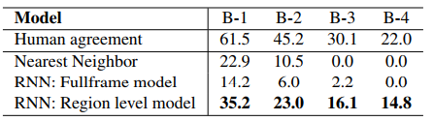
Region model outperforms full frame model and ranking baseline.
This data is evaluated as a prediction task from a 2D array of pixels to a sequence of words and record the BLEU score.
The ranking baseline retrieves training sentence substrings most compatible with each region as judged by the BRNN model.
The full frame model was trained only on full images, so feeding it smaller image regions deteriorates its performance.
Table 3 . BLEU score evaluation of image region annotations.

Slide 31
Limitations
This model can generate a description of one input array of pixels at a fixed resolution.
This model receives the image information only through additive bias interactions, which are known to be less expressive than more complicated multiplicative interactions.
This approach consists of two separate models.

Slide 32
Conclusions
A model that generates natural language descriptions of image regions based on weak labels in form of a dataset of images and sentences, and with very few hardcoded assumptions.
This model aligned parts of visual and language modalities through a common, multimodal embedding.
This model provides state of the performance on image ranking experiments.
This model described a MRNN architecture which generates descriptions on visual data and evaluated on both full frame and region-level experiments.

